Slide 1
Automated Detection of
Visual Contents for
Film Censorship
Student Name : Hor Sui Lyn
Student ID : 1161300122
Majoring : CE
Supervisor : Dr. Sarina binti Mansor
Moderator : Dr. Hezerul Bin Abdul Karim

Slide 2
Introduction
Unconstrained and freely accessible through the Internet
Adolescents and children may take it as normality or curious to try
Distort healthy sexual development
Censorship prevents exposure

Slide 3
Problem statement
Manual detection:
Limited human attention span
Training to know the standards
Automation of pornographic scene detection
Challenge:
Wide range of colours and textures of exposed skin

Slide 4
Project objective
To obtain and study pornographic data set from existing data set
To study various image processing techniques to detect explicit scene from video
To evaluate various CNN features and their encoding strategies

Slide 5
Project scope
Detection of pornographic visual contents
Pornography: “any sexually explicit material with the aim of sexual arousal or fantasy” ¹
Deep learning via CNN
Specialises in automatic pattern and object detection
Automated detection without human intervention is achievable
Frames extracted from videos = image

Slide 6
Literature review
Digital Image Processing Techniques: 2
SVM Classifiers: 1
Deep Learning: 7

Slide 7
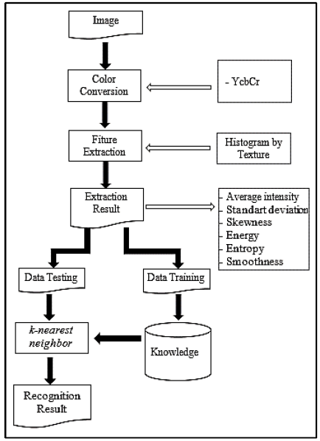
Digital image processing techniques (1)
Implementation of K-NN Based on Histogram at Image Recognition for Pornography Detection ²
Training: 2 images per category
Accuracy: 90% (on 60 Google images)
Limited to cases where distribution of exposed skin area is similar to training data

Slide 8
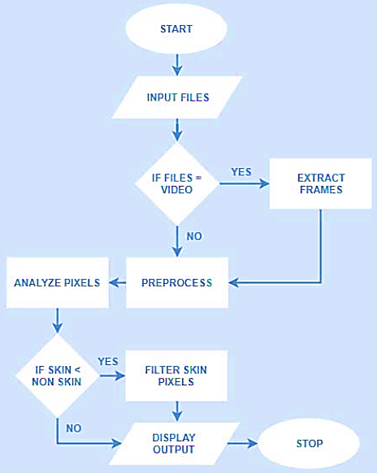
Digital image processing techniques (2)
A Pornographic Image and Video Filtering Application Using Optimized Nudity Recognition and Detection Algorithm ³
Pixel-by-pixel segmentation
Rule-based classification
Various lighting condition
Accuracy: 80.23%
Assumption: pornographic contents include nudity
Tedious to specify the conditional expressions

Slide 9
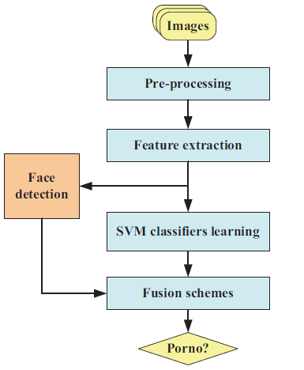
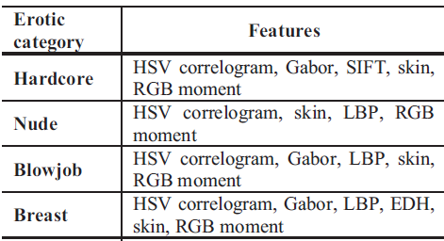
Svm classifiers
Combining Multiple SVM Classifiers for Adult Image Recognition ⁴
Training: 5-fold cross-validation, supervised learning
TP: 87.68%, FP: 14.17% (on 50k Internet images)
Different features for different categories
Face detection algorithm may eliminate pornographic images

Slide 10
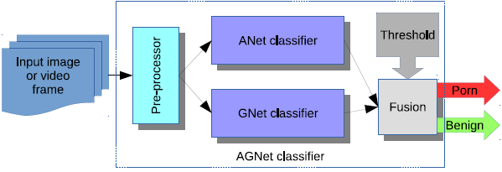
Deep learning (1)
(ImageNet)
Applying Deep Learning to Classify Pornographic Images and Videos ⁵
(ImageNet)
[C++]
ANet and GNet: Transfer learning, only last layer re-trained
For frame: Compare threshold with averaged scores (AGNet) or max score (AGbNet)
For video: Majority voting on key frames
Accuracy: 93.8% (AGNet, on NPDI dataset); 94.1% (AGbNet, on NPDI dataset)
Assumption: ANet and GNet produce different classification errors
Higher computational power (if run in parallel)

Slide 11
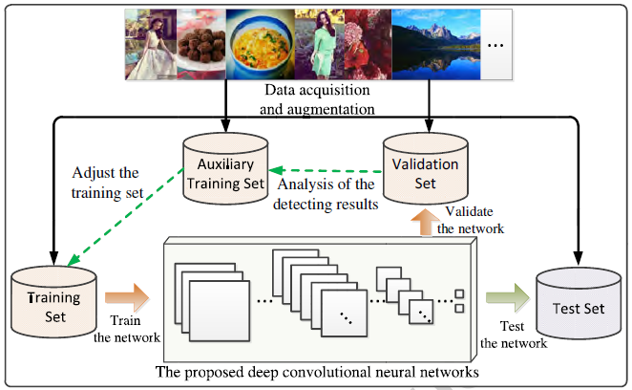
Deep learning (2)
Pornographic Image Detection Utilizing Deep Convolutional Deep Networks ⁶
Transfer learning, parameters trainable
Data augmentation
CaffeNet
(ImageNet)
Relationship between validation results and training set distribution used to fine-tune network, repeat until test accuracy converges
Fixed-point algorithm: to speed up computation time (-0.86% accuracy)
Accuracy: 98.6% (on test data)

Slide 12
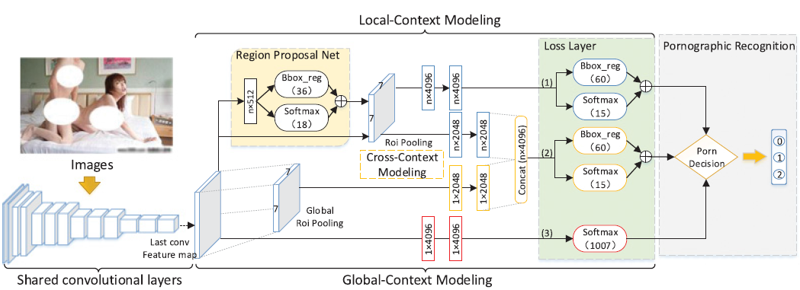
Deep learning (3)
Adult Image and Video Recognition by a Deep Multicontext Network and Fine-to-coarse Strategy ⁷
Deep Fast R-CNN
DMCNet
[CAFFE]
(ImageNet)
Deep CNN

Slide 13
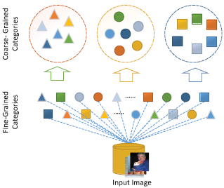
Deep learning (3)
Classes: S00, S01, S02
Transfer learning, network fine-tuned
Fine-to-coarse strategy: accelerate detection process
Accuracy: 99.1% (on L2 dataset), 97.8% (on L3 dataset)
Higher complexity leads to longer development time
Classes: S00, S01+S02
Dataset:
S00: normal
S01: adult
S03: unsuitable for children

Slide 14
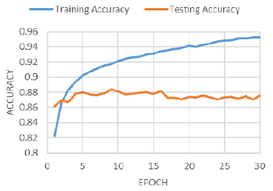
Deep learning (4)
Convolutional Neural Network for Pornographic Images Classification ⁸
- Difficulty in classification in current fold is decreased significantly compared to other folds
VGG-16 [Python, Keras framework]
Transfer learning
5-fold cross-validation
Accuracy: 95.4% (training on NPDI dataset), 93.8% (testing on NPDI dataset)

Slide 15
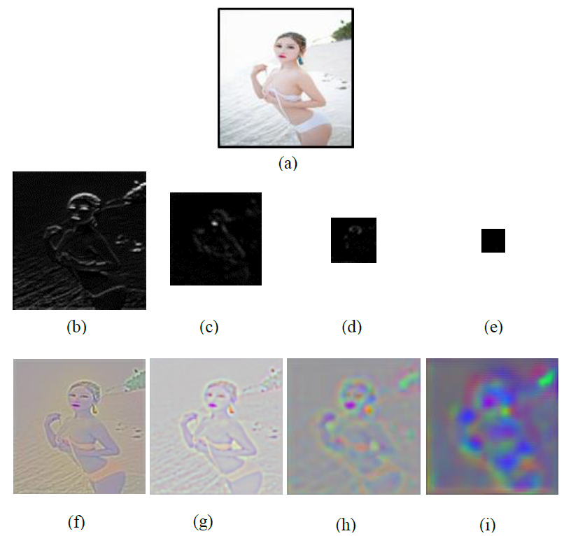
Deep learning (5)
A Deep Network for Pornographic Image Recognition Based on Feature Visualization Analysis ⁹
VGG-16 and CaffeNet
Transfer learning (exclude last 3 FC)
Features extracted visualised to determine data augmentation method
Display forward output (direct)
De-convolute feature, then output as image
Max accuracy: 94.7% (increase of 2.6% from using fine-tuned VGG-16)
Requires human intervention to decide data augmentation method to improve results

Slide 16
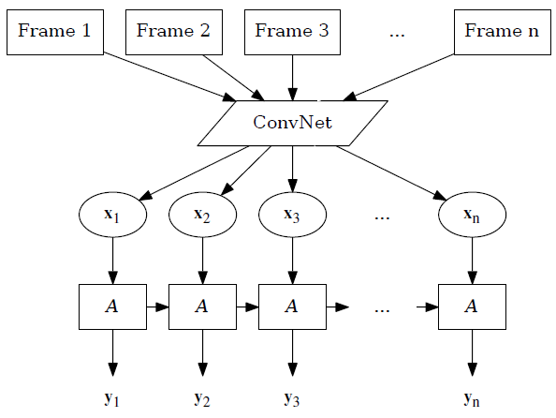
Deep learning (6)
transfer learning
training not required
Adult Content Detection in Videos with Convolutional and Recurrent Neural Networks ¹⁰
Video frames extracted
CNN + multiple cropping for feature extraction
LSTM (RNN) for sequence learning
Video classification: majority voting
Max accuracy: 95.6% by ACORDE-101 (on NPDI dataset)
Useful in real-time applications
ACORDE
- training required

Slide 17

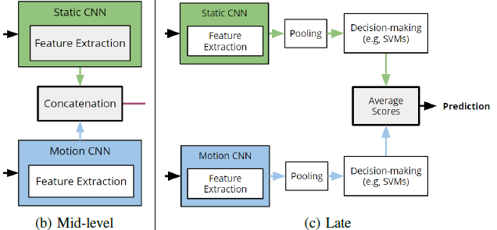
Deep learning (7)
(ImageNet)
Video Pornography Detection through Deep Learning Techniques and Motion Information ¹¹
(ImageNet)
transfer learning
Static feature extraction and all classifications: GoogLeNet (CNN)
Motion (temporal) information extraction:
Optical flow displacement field (magnitude and direction)
MPEG motion vector (Movement of macroblock represented using motion vector)
Accuracy: 96.4% with Late Fusion (on Pornography-2k dataset), 97.9% with Mid-level or Late Fusion using optical flow method (on Pornography-800 dataset)

Slide 18
Summary of literature review
Digital image processing techniques and SVM classifiers:
Rely on assumptions that affect accuracy
Human intervention required
Deep learning (CNN):
Learn without human intervention
Feature to be extracted decided automatically
Dataset has to cover a wide range in an unbiased way
K-fold cross-validation not suitable
=> manual distribution of training and validation dataset
Experiment on:
CNN with and without transfer learning to extract features
Different classifiers (CNN and SVM)

Slide 19
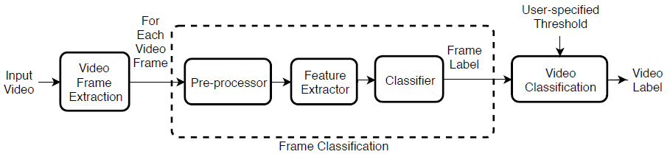
System architecture

Slide 20
Data distribution & CNN architectures
Dataset | “Non Porn” Images | “Porn” Images | Total
Training | 11,872 | 4,531 | 16,403
Validation | 2,386 | 988 | 3,374
Total | 14,258 | 5519 | 19,777
804 videos (402 “Non Porn” and 402 “Porn”) and 727 images (all “Porn”) from Internet
CNN Architecture | Number of Layer
MobileNet | 30
VGG-19 | 19
ResNet50_V2 | 50

Slide 21
cnn implementation techniques
Transfer learning (ImageNet)
Data augmentation
Dropout layer
Reduction of network capacity
L1 kernel regularisation

Slide 22
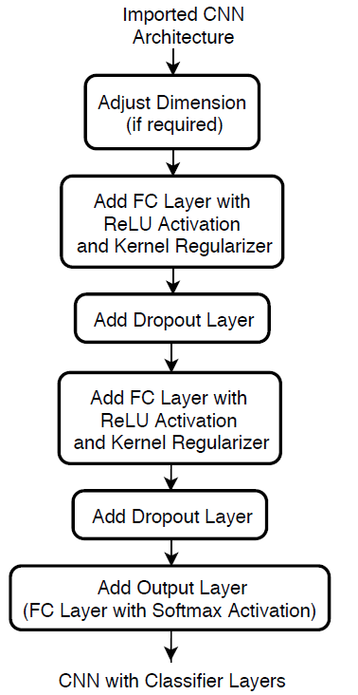
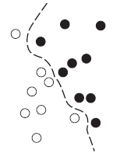
Methods of cnn implementation
Method | Feature Extractor | Classifier
1 | Traditional CNN | CNN
2 | Fine-tuned CNN | CNN
3 | Traditional CNN (from Method 1) | SVM
4 | Fine-tuned CNN (from Method 2) | SVM
RMSprop optimizer
Categorical cross entropy loss
Learning rate = 0.0001
Batch size (train) = 32
Batch size (validation) = 16
Number of epoch = 20

Slide 23
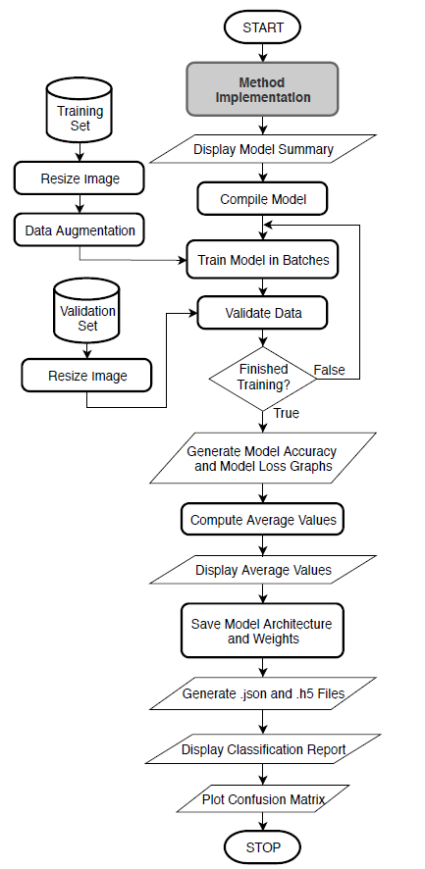
Flowchart of Method 1 and Method 2

Slide 24
Results (method 1)
CNN Model | Number of Neuron | Number of Trainable Parameter | Elapsed Time (hh:mm:ss) | Validation Accuracy (%)
MobileNet | (64, 8) | 3,273,114 | 02:00:24 | 86.40
 | (96, 24) | 3,307,754 | 02:01:14 | 86.93
 | (128, 36) | 3,342,894 | 02:02:53 | 86.43
VGG-19 | (64, 8) | 21,630,618 | 02:01:22 | 84.65
 | (96, 24) | 22,435,306 | 02:02:08 | 82.13
 | (128, 36) | 23,240,494 | 02:03:07 | 83.91
ResNet50_V2 | (64, 8) | 29,942,490 | 02:06:42 | 84.88
 | (96, 24) | 33,155,626 | 02:07:36 | 86.54
 | (128, 36) | 36,369,262 | 02:08:02 | 86.72

Slide 25
Results (method 2)
CNN Model and Number of Neuron | Number of Trainable Layer | Number of Trainable Parameter | Elapsed Time (hh:mm:ss) | Validation Accuracy (%)
MobileNet (96, 24) | 10 | 1,689,002 | 01:10:02 | 88.77
 | 20 | 1,963,434 | 01:10:32 | 90.78
 | 30 | 2,496,426 | 01:11:36 | 91.82
VGG-19 (64, 8) | 5 | 11,045,466 | 01:10:43 | 91.79
 | 8 | 15,765,082 | 01:11:36 | 88.53
 | 10 | 19,305,050 | 01:12:26 | 87.20
ResNet50_V2 (128, 36) | 20 | 20,729,582 | 01:13:54 | 92.68
 | 30 | 27,293,422 | 01:14:12 | 91.35
 | 50 | 29,202,158 | 01:15:07 | 89.72

Slide 26
Results (method 3 & method 4)
CNN Model | Number of Neuron | Number of Feature |  | Elapsed Time (mm:ss) | Validation Accuracy (%)
 |  | Train | Validation
MobileNet | (96, 24) | 1,574,688 | 323,904 | 01:15 | 87.05
VGG-19 | (64, 8) | 1,049,792 | 215,936 | 02:14 | 84.91
ResNet50_V2 | (128, 36) | 2,099,584 | 431,872 | 02:21 | 86.84
CNN Model and Number of Neuron | Number of Trainable Layer | Number of Feature |  | Elapsed Time (mm:ss) | Validation Accuracy (%)
 |  | Train | Validation
MobileNet (96, 24) | 10 | 1,574,688 | 323,904 | 01:08 | 92.77
VGG-19 (64, 8) | 5 | 1,049,792 | 215,936 | 02:11 | 90.57
ResNet50_V2 (128, 36) | 50 | 2,099,584 | 431,872 | 02:15 | 92.80

Slide 27
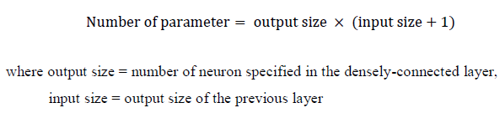
Discussion of findings (1)
Number of neuron & number of trainable layer – number of trainable parameter
SVM classifier: Number of neuron in layer used as input to classifier – number of extracted feature
Number of trainable parameter – elapsed time
Number of trainable parameter is less with transfer learning (Method 1 > Method 2)
No particular pattern for hyperparameter (number of neuron, number of trainable layer) manipulation

Slide 28
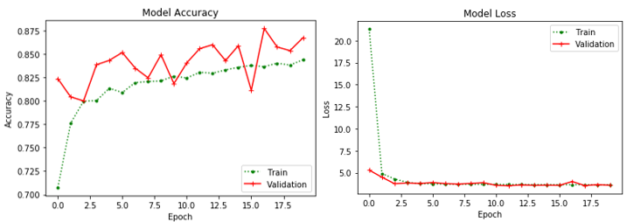
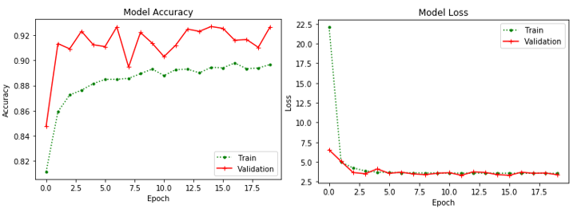
Discussion of findings (2)
Transfer learning
Effectiveness affected by relationship between source task and target task
Fluctuation of validation accuracies
SVM > CNN as classifier
ResNet50_V2, (128, 36) Model Accuracy and Loss Graphs [Method 1]
ResNet50_V2 (20 Layers) Model Accuracy and Loss Graphs [Method 2]

Slide 29
Discussion of findings (3)
Method | CNN Model
1 | MobileNet with (96, 24) neurons
2 | ResNet50_V2 with (128, 36) neurons and last 20 layers in convolutional base trainable
3 | MobileNet with (96, 24) neurons
4 | ResNet50_V2 with (128, 36) neurons and last 20 layers in convolutional base trainable
Automated Detection Achieved!

Slide 30
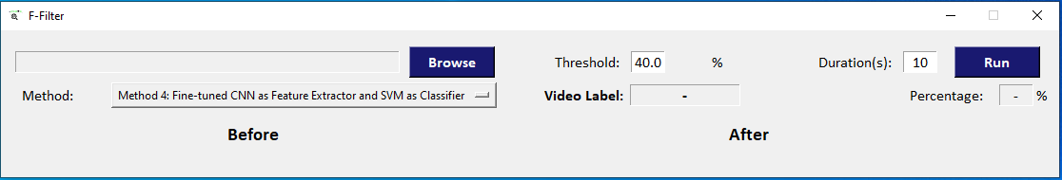
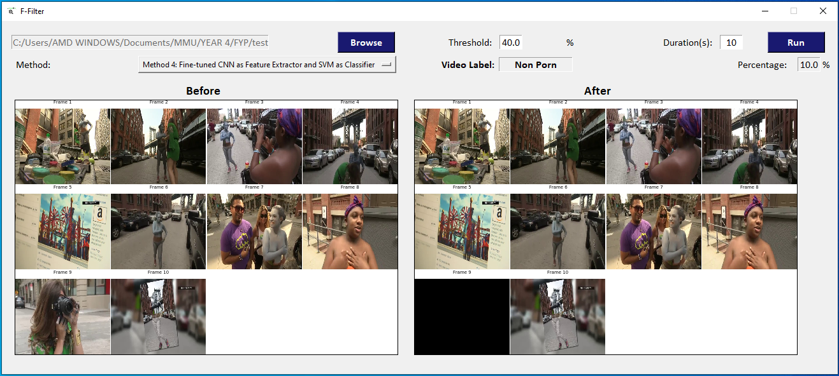
Implemented GUI (f-filter)
Upon Launching
After a successful run

Slide 31
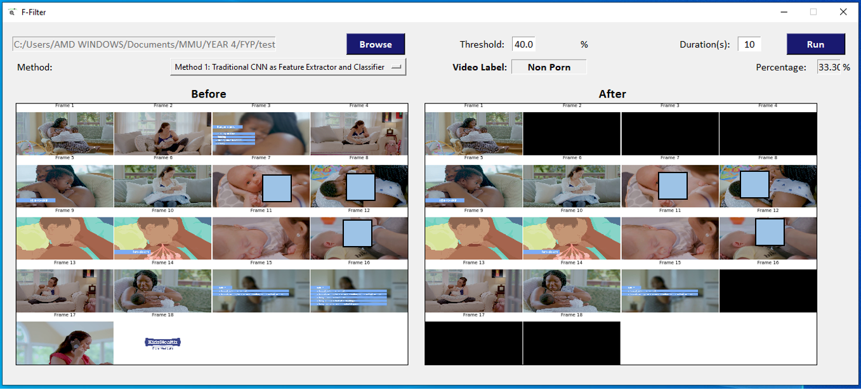
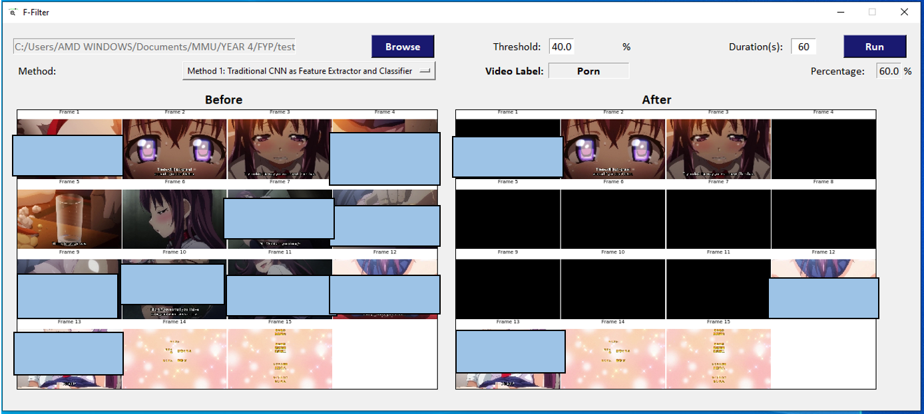
Implemented GUI (f-filter) – METHOD 1
Pornographic anime
Breastfeeding video

Slide 32
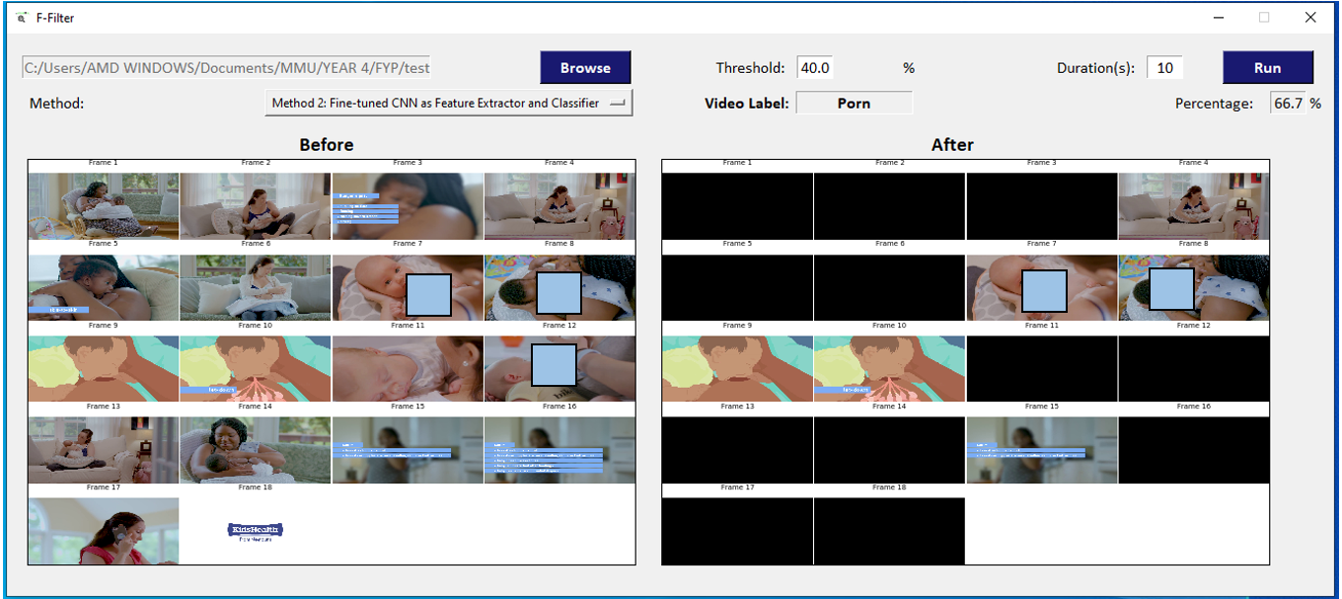
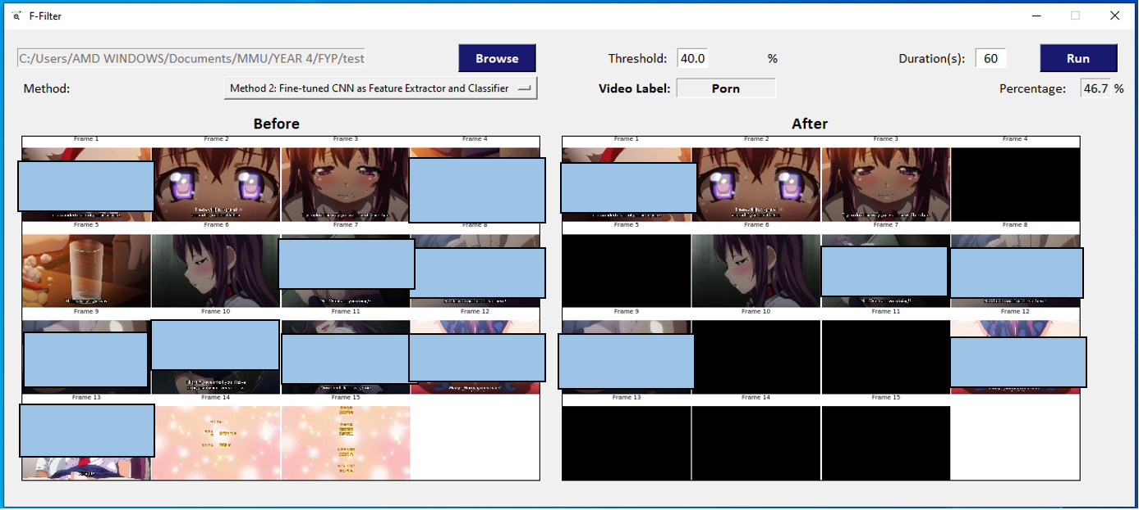
Implemented GUI (f-filter) – METHOD 2
Pornographic anime
Breastfeeding video

Slide 33
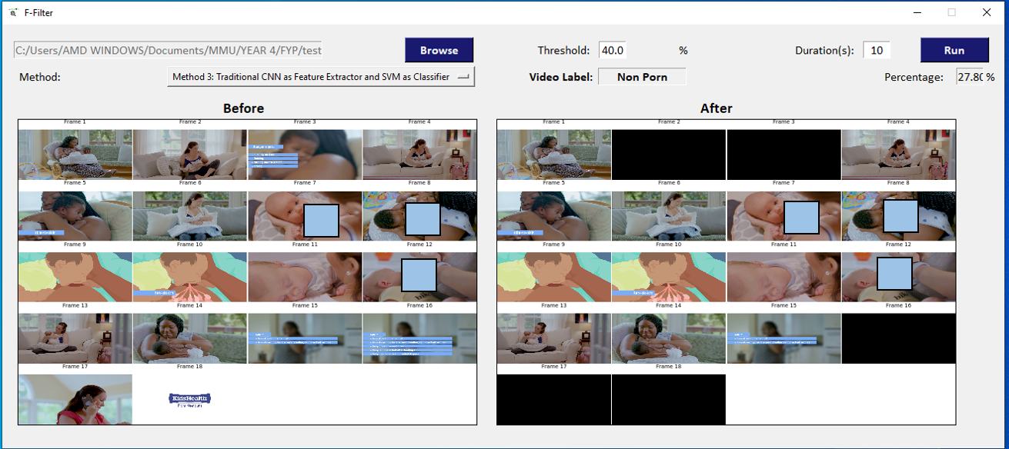
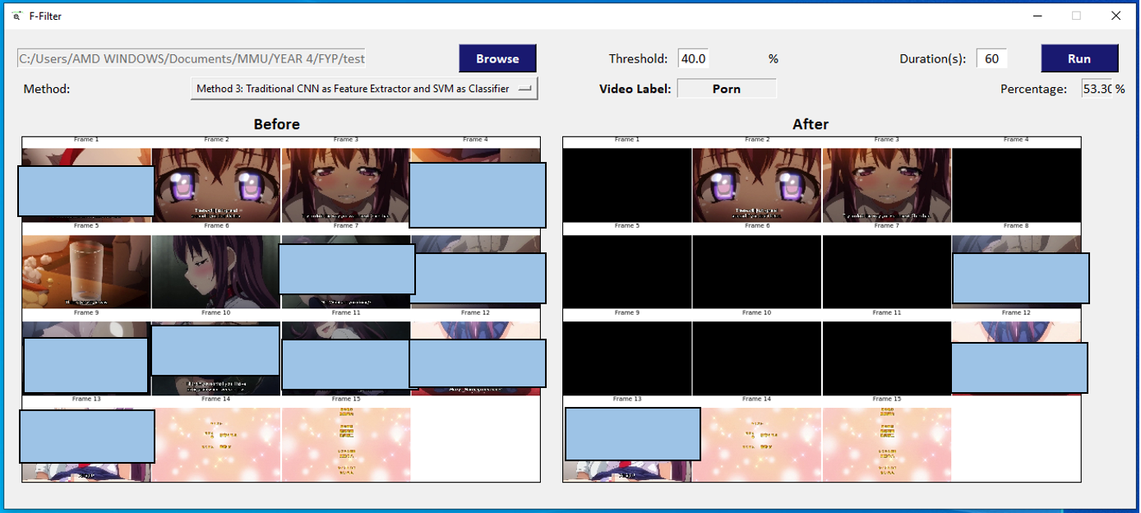
Implemented GUI (f-filter) – METHOD 3
Pornographic anime
Breastfeeding video

Slide 34
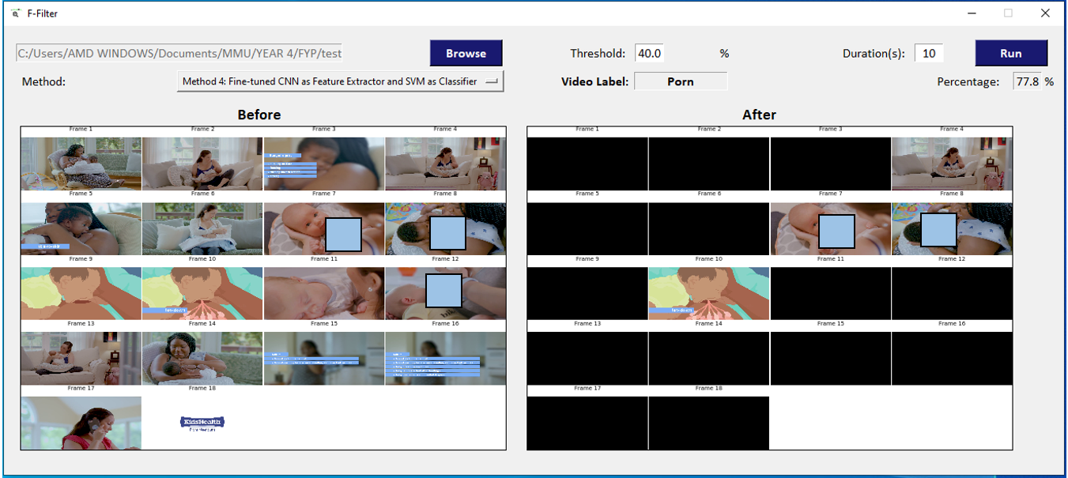
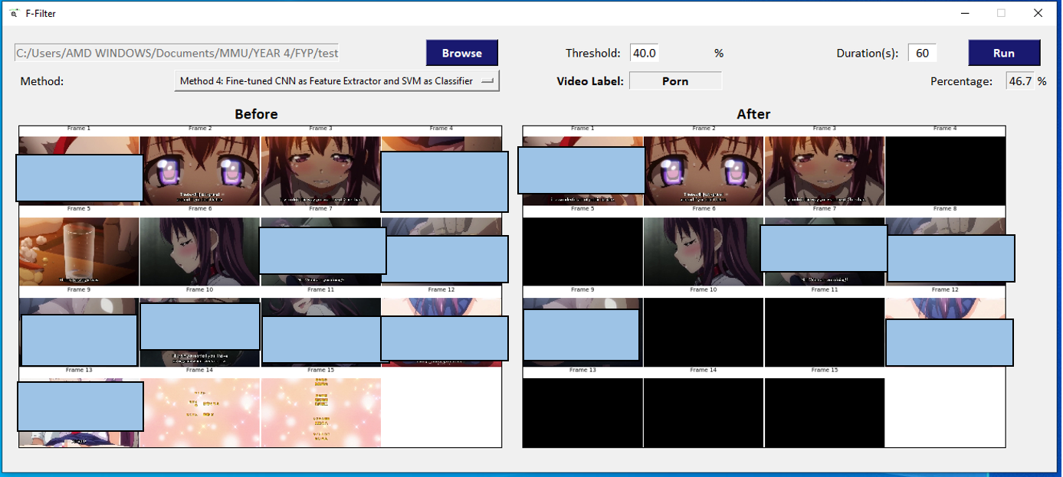
Implemented GUI (f-filter) – METHOD 4
Pornographic anime
Breastfeeding video

Slide 35
conclusion
Best method: Method 4 [using ResNet50_V2, (128, 36), 20 layers trainable] with validation accuracy of 92.80%
Deep learning via CNN can be used for automated detection of inappropriate visual content in films
Transfer learning can improve CNN performance
SVM classifier performed better than CNN classifier

Slide 36
Future work
Hyperparameter tuning or model optimization
Trying other optimisers
LSTM (RNN) which allows sequence learning ¹⁰
Adjustments to training data ⁶
Incorporate filtering process

